Slide 1
Software Engineering Fundamentals
Assignment 1
Giacomo Ricco / Simon Li / Yuhang Lin
Kohei Kuramoto / Max Linghag Ahlgren

Slide 2

Collaboration and Communication
A good channel of communication is key
A high quality collaboration and support when needed
An division of the load of work among the developers with a “Divide et Impera” approach

Slide 3


Synchronous and asynchronous communication
Utilizing Both Approaches for Effective Collaboration
Direct Communication and Rapid Responsiveness
Independent Work Progression
Focus on different modules at the same time

Slide 4
Tools, Software and Programming Language
Development Environments
Visual Studio Code and Intellij IDEA
Testing Framework
Apache Maven
Version Control and Collaboration
Git and Github
Communication Platforms
Discord and WhatsApp
Document Sharing and Information Management
Google Docs
Programming Language
Java, following an OOP Approach

Slide 5
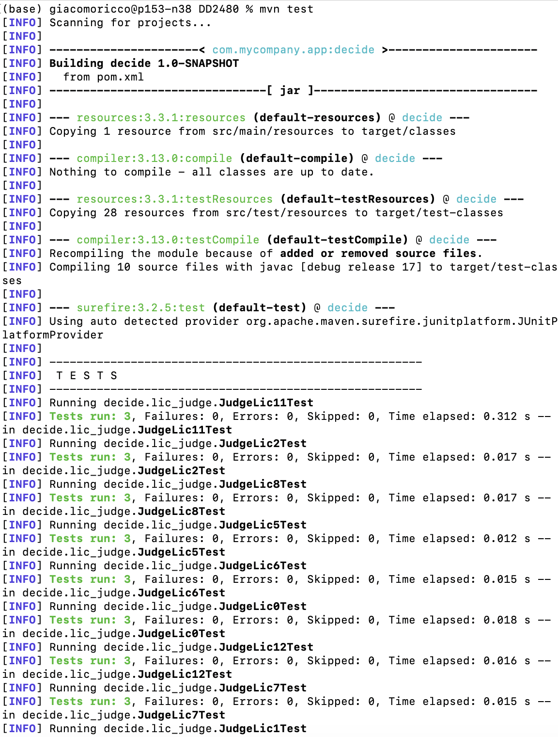



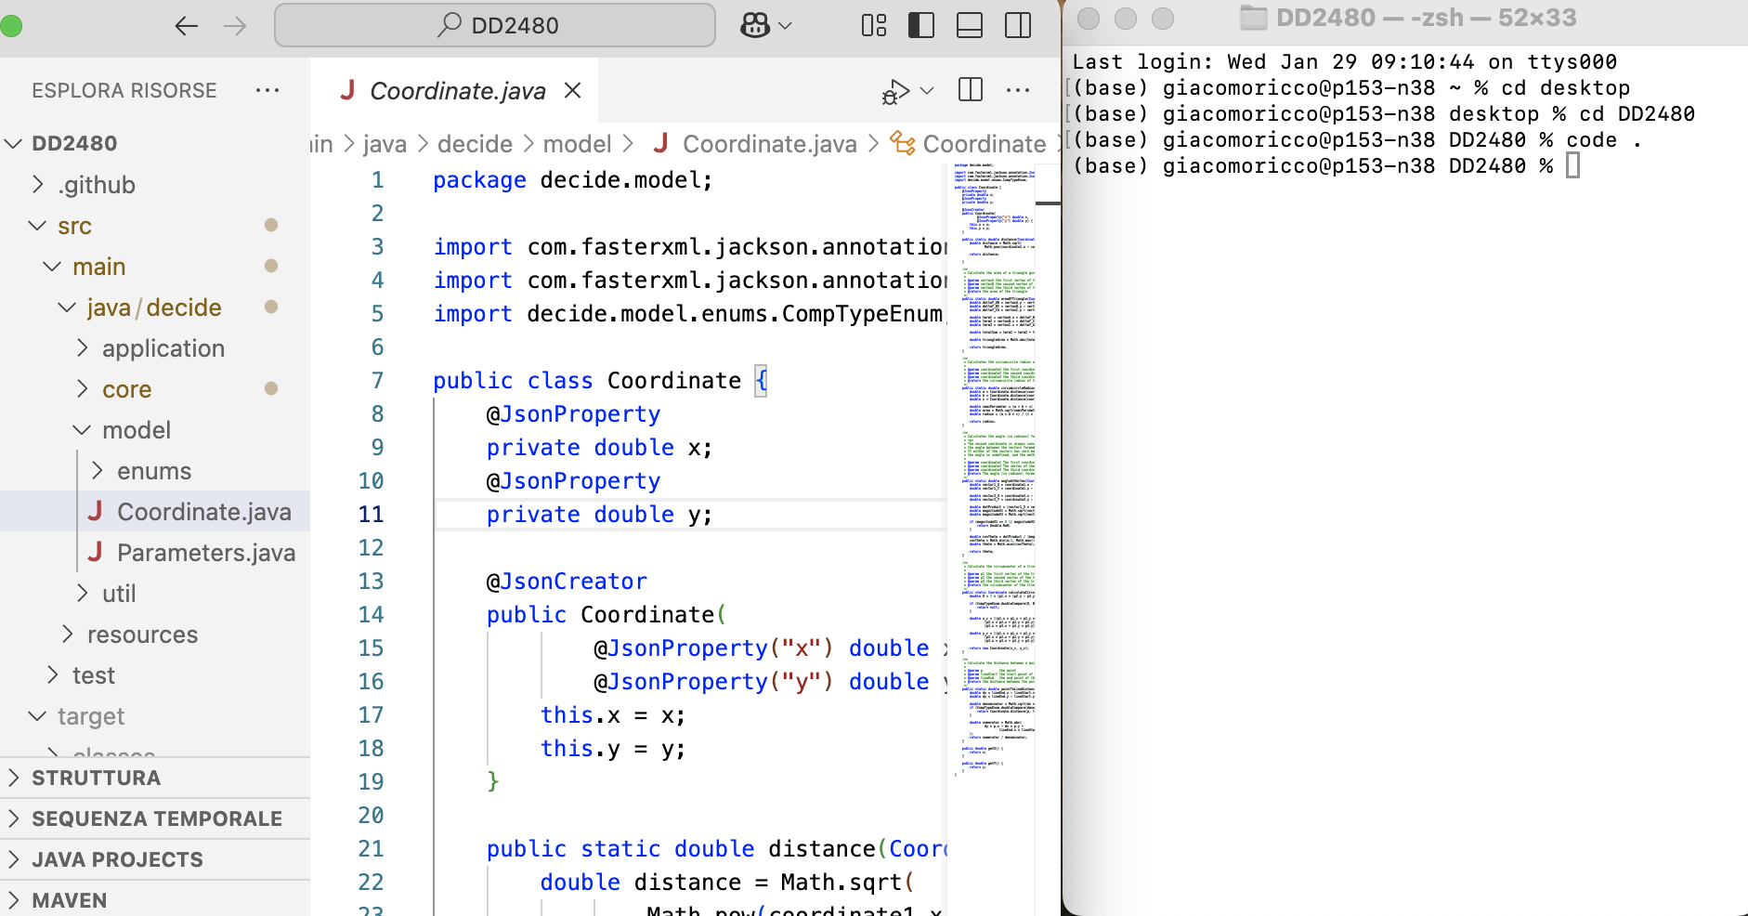
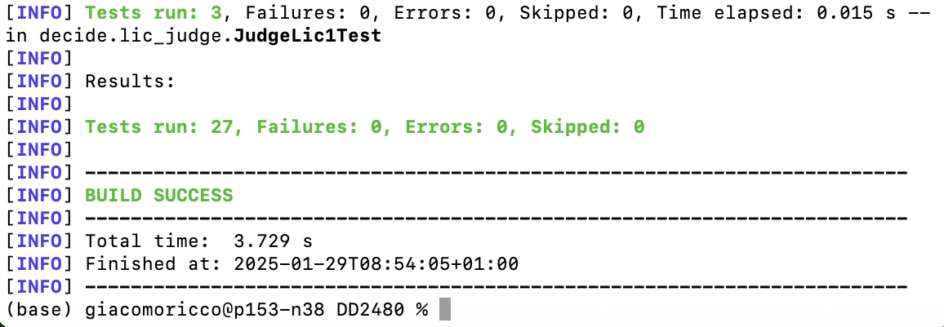
Tools, Software and Programming Language (2)

Slide 6
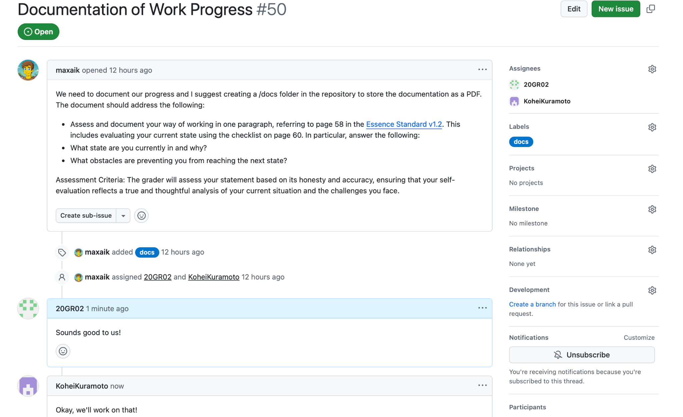
Git issue
Assigned members
The overview of an issue
Comments for the issue

Slide 7
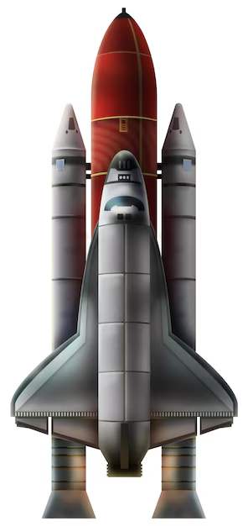
Description of the problem and main functions
Problem Description:
- Project: Launch Interceptor Program.
- Goal: determine whether an interceptor should be launched based on radar tracking data.
Main Function (DECIDE()):
Inputs:
NUMPOINTS:
Number of planar data points (2 ≤ NUMPOINTS ≤ 100).
POINTS:
Array of coordinates (X[i], Y[i]).
PARAMETERS:
Struct with thresholds for LICs (e.g., LENGTH1, RADIUS1, EPSILON).
LCM:
Logical Connector Matrix (15×15) with values ANDD, ORR, NOTUSED.
PUV:
Preliminary Unlocking Vector (15 elements, boolean).

Slide 8
Description of the problem and main functions (2)
Processing:
Evaluate 15 Launch Interceptor Conditions (LICs) → Create a Conditions Met Vector (CMV).
Use a Logical Connector Matrix (LCM) → Combine LICs into a Preliminary Unlocking Matrix (PUM).
Apply a Preliminary Unlocking Vector (PUV) → Generate a Final Unlocking Vector (FUV).
All values in FUV are true → The interceptor is launched.
Outputs:
CMV: Conditions Met Vector (15-element boolean array).
PUM: Preliminary Unlocking Matrix (15×15 boolean matrix).
FUV: Final Unlocking Vector (15-element boolean array).
LAUNCH: Final decision("YES" - launch) or ("NO" - no launch).

Slide 9
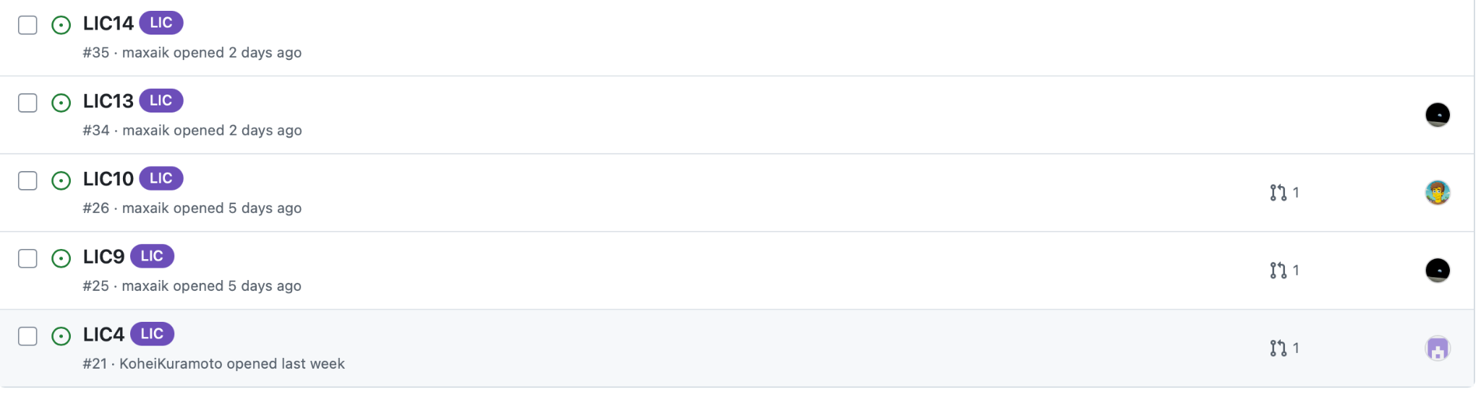
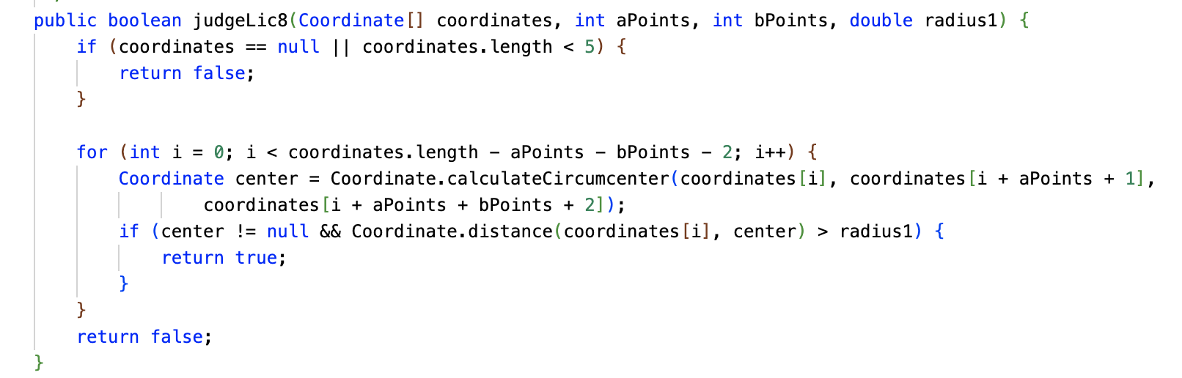
LICs
Once built the skeleton
Opened an issue for LIC & Assigned it a developer.
The developers split the work
Simultaneous Progression.
Each LIC is implemented as a dedicated function that evaluates specific spatial conditions of the given data points.
Example:
"judfeLic8"
checks whether certain data points can be enclosed within a circle of a predefined radius.

Slide 10
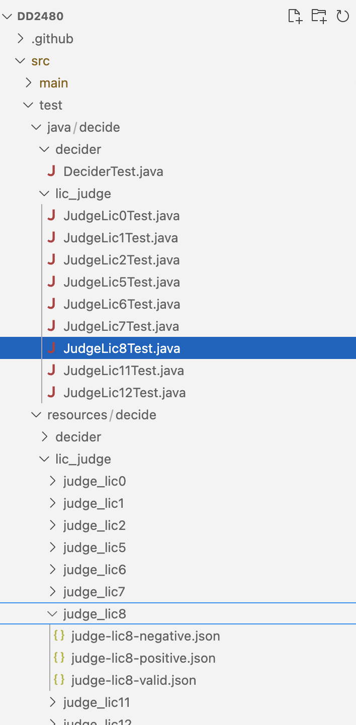
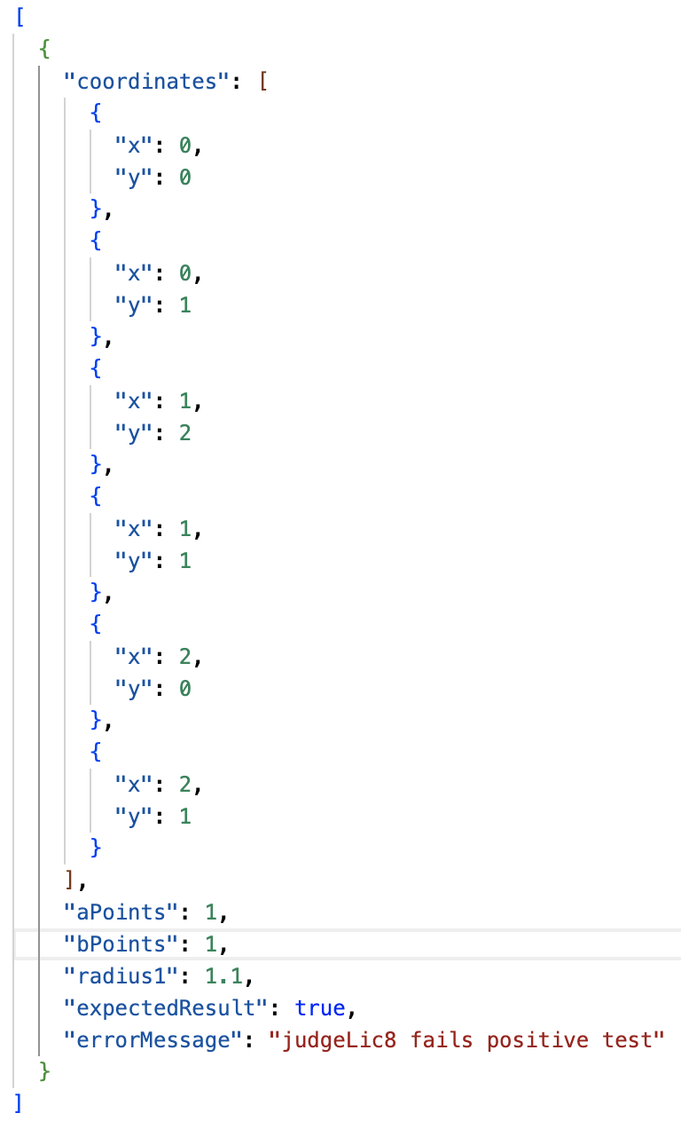
Testing Cases
Each LIC function, as well as the main function, has been thoroughly tested within a dedicated testing section.
Since each LIC function returns a boolean value, three standard test cases were considered for each condition to ensure comprehensive validation:
Validity Test – Confirms the function behaves as expected under normal conditions.
Positive Test – Ensures the function correctly identifies a condition when it should return true.
Negative Test – Verifies that the function correctly returns false when the condition is not met.
This structured testing approach ensures the robustness and reliability of the LIC functions.

Slide 11
Workflow & Used Git commands
Commands ↓
git fetch - get changes
git merge - Merge changes
git pull - get the latest code
git checkout (branchname)
- switch to another branch
git checkout -b (branchname) - create and switch to branch the new branch
git add (filename)
- stages changes in the file
git commit -m “message here”
- commits local changes
git push -u origin (branchname)
- push local branch
5. Create a pull request
6. Review pull request
Reviewed by other members
7. Merge
Create an issue
Labels are used depending on
Ex. feat, fix and bug
Create a branch
Branch specific to the issue
Write code
Following Commit message format
Push code

Slide 12

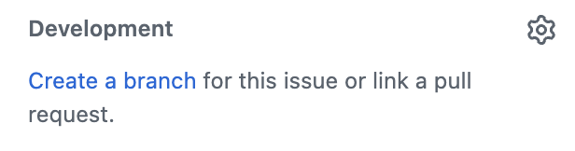

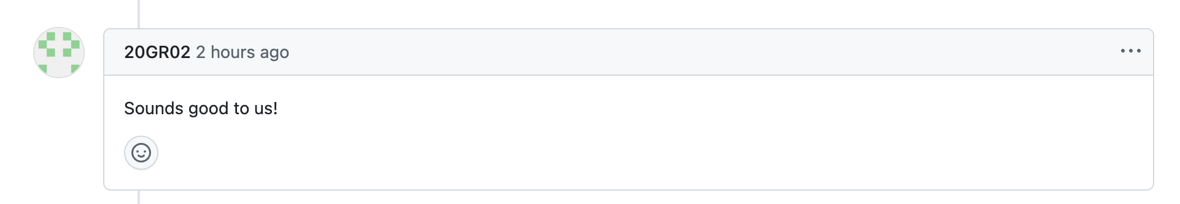
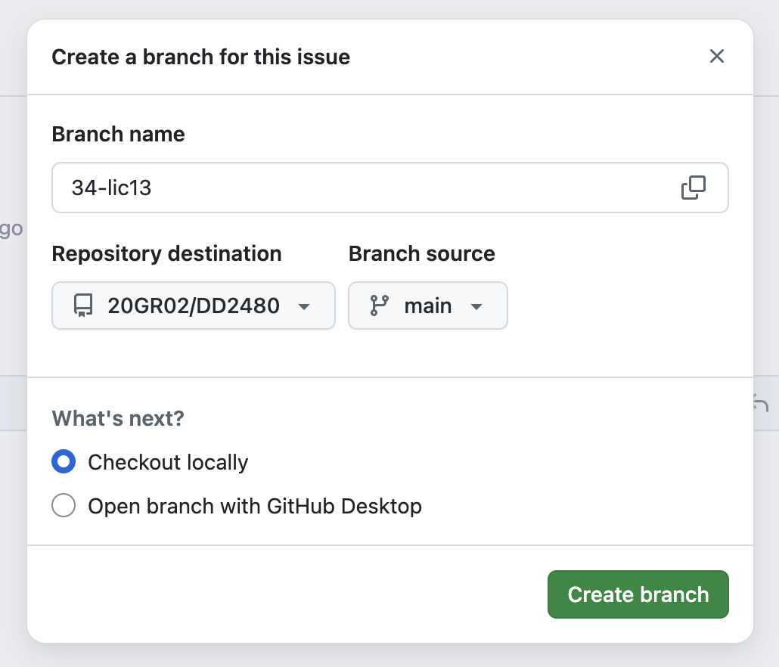
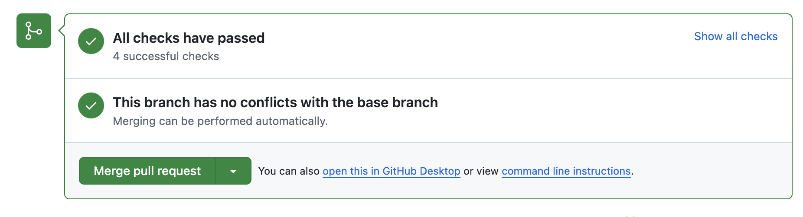
Workflow & Used Git commands (2)
Reviewers in charge of merging give feedback and merge

Slide 13
Thank you for listening

